Slide 1


INTEGRATED HEALTHCARE MANAGEMENT SYSTEM: Enhancing Management, Medication And Data Visualization
Group Members
Abubakari Al-Waasiu - 10903301
Luornor Nathan Tettey – 10869956
Project Supervisor
Dr. Percy Okae
UNIVERSITY OF GHANA

Slide 2

OUTLINE
INTRODUCTION
PROBLEM DEFINITION
RELEVANCE OF WORK
OBJECTIVES
LITERATURE REVIEW
PROPOSED SYSTEM OVERVIEW
SYSTEM REQUIREMENTS
WORKING SYSTEM OVERVIEW
RESULTS
DISCUSSION
PROJECT TIMELINE
CONCLUSION

Slide 3
INTRODUCTION
The project aims to transform healthcare delivery through an integrated health information system for seamless access to patient data.
It unifies healthcare data across departments to enhance efficiency and accuracy in patient care.
The system improves data visualization for better health information interpretation by patients and providers.
It enhances communication between patients and healthcare providers, both remotely and in-person.
By fostering better coordination, it promotes greater patient engagement and effective treatment management.

Slide 4
PROBLEM DEFINITION
Difficulty in unifying healthcare data across departments
Patients do not have access to their own medical records
Difficulty in health data interpretation due to lack of visuals
Poor medication tracking on the part of patients
Lack of communication between patients and healthcare providers

Slide 5
RELEVANCE OF WORK
Synchronize health data of patients across department into a unified database
Allow patients to view to their personal records for better health decisions
Simplify health data interpretation by visualizing the data
Implement a medication tracking system for better patient medication
Introducing telemedicine platform for communication between patients and doctors.

Slide 6
OBJECTIVES
Develop a web application that is used to manage the patients health records
Integrate charts into the web application to enable patients visualize their health trends
Develop a unified database for the storage of the health data from the web application
Implement a medication tracking system
Implement a video conferencing platform for doctors to communicate with patients remotely

Slide 7
EXISTING WORKS
AUTHOR | TITLE | OVERVIEW | ACHIEVED | GAP
Abdul-Aziz, M et al | Lightwave Health Information Management System (LHIMS), 2022 | Enhancing healthcare data management and accessibility at local levels. | The LHIMS has increased the accuracy of patient records by 95%. | The system does not have a unified database

Slide 8
EXISTING WORKS
AUTHOR | TITLE | OVERVIEW | ACHIEVED | GAP
Yuki, Rviuchi et al | Present State and the Future of Health Data Utilization NTT DATA Envisions. 2021 | Integrating technology for patient-centric care, addressing medical needs efficiently and innovatively | Highly secure and reliable data center infrastructure | Cost of services are relatively higher compared to other system.

Slide 9
EXISTING WORKS
AUTHOR | TITLE | OVERVIEW | ACHIEVED | GAP
Anderson White et al | Security Measures in Healthcare Systems: Current Trends and Future Directions. 2020 | Providing health care solutions incliding EMRS, clinical softwares and enhancing healthcare | Used by over 70% of GPs in England. 37% of community pharmacies in early 2023. | The system does not include telemedicine functionalities.

Slide 10
EXISTING WORKS
AUTHOR | TITLE | OVERVIEW | ACHIEVED | GAP
Wu Yang et al | WeDoctor: A review of China's largest mobile healthcare platform, 2020 | Digitalizing healthcare with telemedicine, appointments, AI, and health management services for patient convenience. | Pioneering AI-Powered Healthcare - “World's Most Innovative Healthcare Company” in 2021 | The system did not support multi-language. Primary language is Chinese

Slide 11
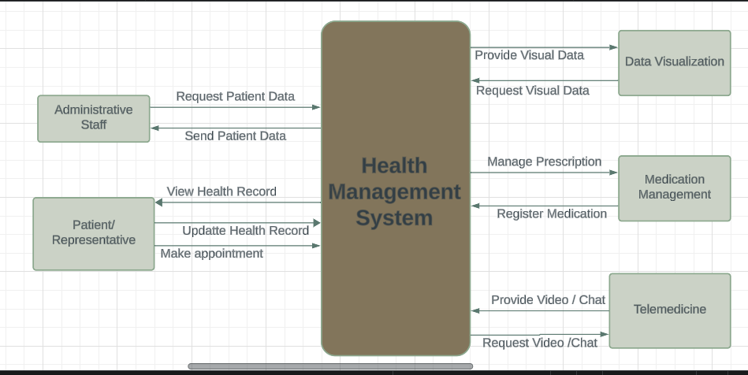
PROPOSED SYSTEM OVERVIEW

Slide 12
SYSTEM REQUIREMENTS
FUNCTIONAL
Centralized database for health data
Health records management
Patient access to medical records
Integrate graphs and charts for data visualization
Implement a tracking and reminder system
Remote consultation between doctors and patients

Slide 13
SYSTEM REQUIREMENTS
NON-FUNCTIONAL
Data security and healthcare regulations compliance .
User-friendly and intuitive interfaces.
Scalability to accommodate a growing user base.
Fast and easy access.
Reliability

Slide 14
WORKING SYSTEM OVERVIEW

Slide 15

SOFTWARE SYSTEM DESIGN
Software development Methodology
Use case modelling and User Interface Design
Database Design
Implementation of User Interface
Backend Integration
External APIs integration

Slide 16
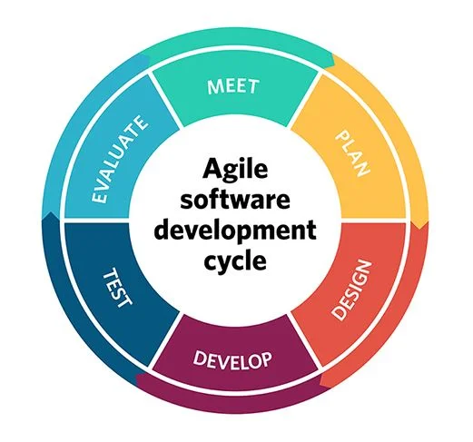
SOFTWARE DEVELOPMENT CYCLE
Agile Software Methodology
It involves breaking the project into phases
Emphasizes continuous collaboration and improvement
Cycle of planning, execution and evaluation
Reduce overheads in software process

Slide 17
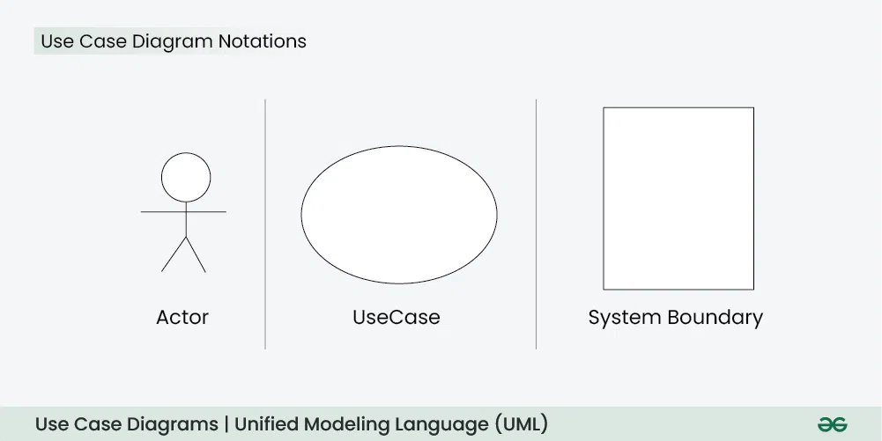
SOFTWARE USE CASES
System Features
Telemedicine Platform
Medication Management
Health Data Management and Visualization.

Slide 18
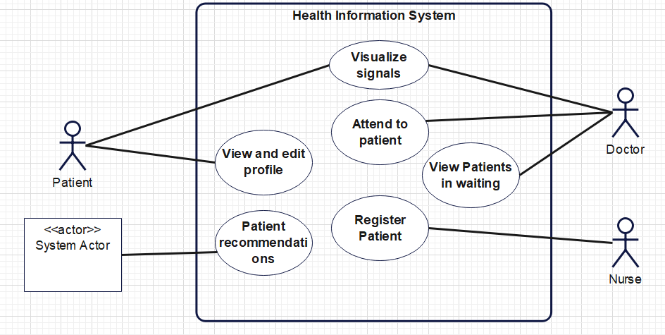
HEALTH DATA MANAGEMENT AND VISUALIZATION USE CASE DIAGRAM
Managing and Visualizing Health Data
Data-Driven Recommendations

Slide 19
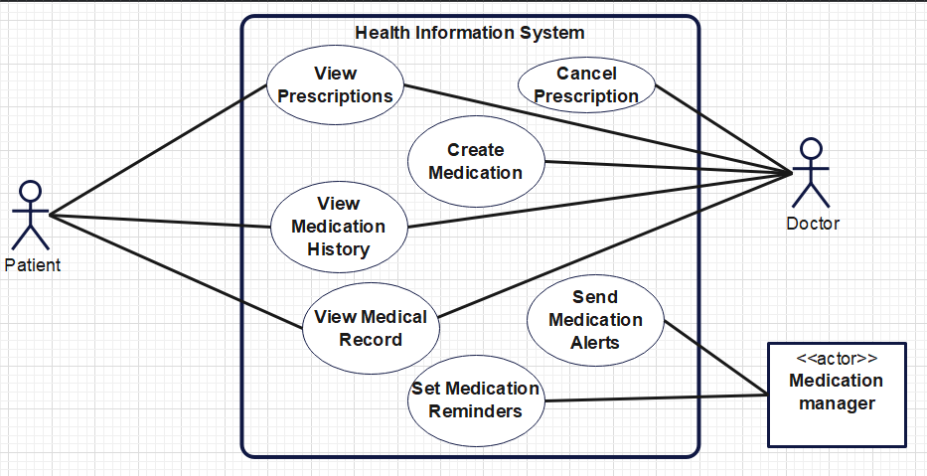
MEDICATION MANAGEMENT USE CASE DIAGRAM
Tracking Prescriptions
Setting Medication Reminders

Slide 20
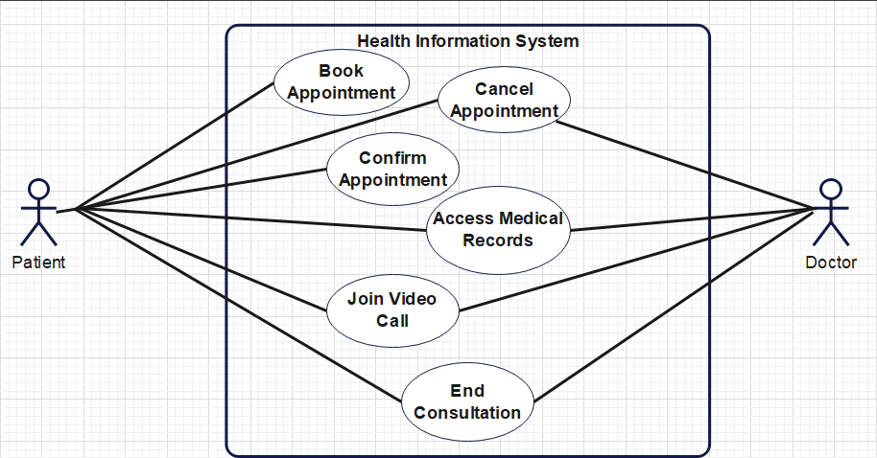
TELEMEDICINE USE CASE DIAGRAM
Streamlining Remote Consultations
Enhancing Data Access

Slide 21









Software User Interface Design
TECHNOLOGIES USED
HTML
CSS
TAILWIND
JAVASCRIPT
CHART.JS

Slide 22

Database Design
FEATURES
Multi User
Enterprise
Centralized
Operational
Semi-structured

Slide 23
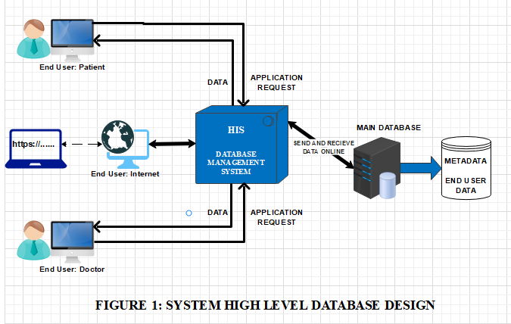
DATABASE OVERVIEW

Slide 24
DATA MODELLING
LINK TO THE DATABASE MODELLING

Slide 25


TASK DELEGATION
Abubakari Al-Waasiu
Nathan Lournor
Frontend Development
Database Design
System Design
Backend Development
Use case Modelling
System Integrations

Slide 26
BUDGET
ACTIVITY | AMOUNT IN GHc
CLOUD HOSTING | 926
TRANSPORTATION | 620
CALL CREDIT AND DATA | 600
DOCUMENTATION | 500
THIRD-PARTY SERVICES | 1249
TOTAL | 3895

Slide 27
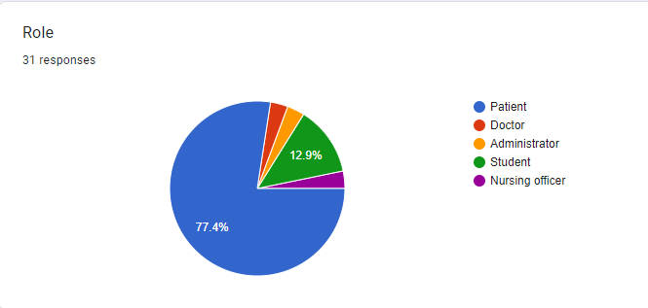
RESULTS

Slide 28
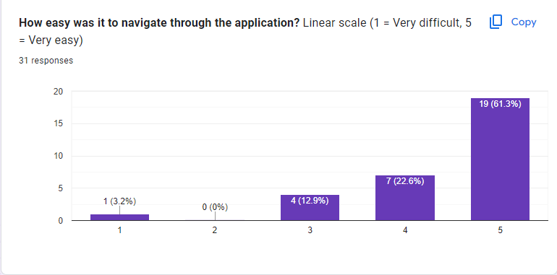
RESULTS

Slide 29
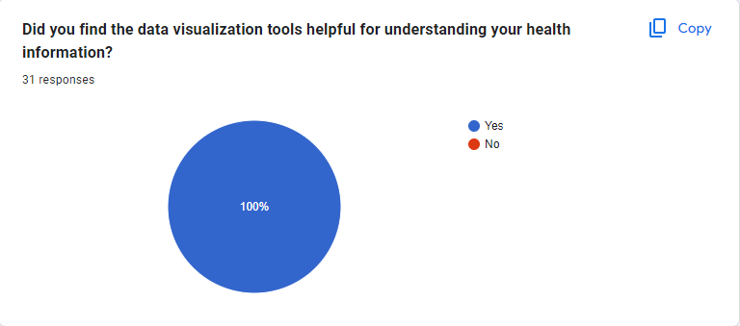
RESULTS

Slide 30
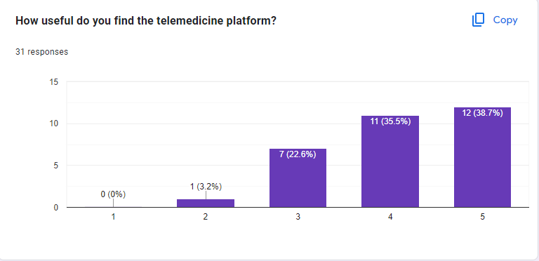
RESULTS

Slide 31
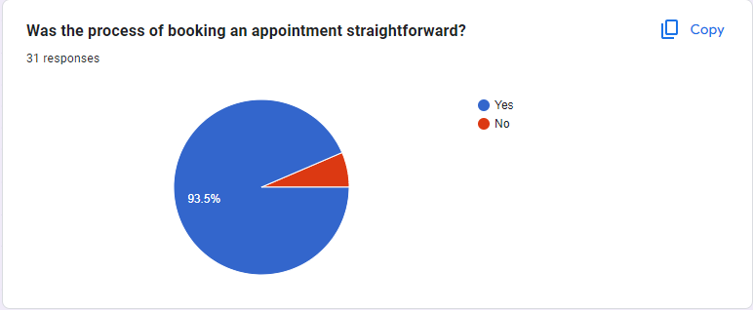
RESULTS

Slide 32
DISCUSSIONS
Most respondents were patients, highlighting the need for self health records management.
100% of users found data visualization tools helpful for understanding health information highlighting the importance of visuals.
74% telemedicine satisfaction shows remote consultations importance.
93% found appointment booking straightforward, stressing user-friendly design.
Patient satisfaction emphasizes the importance of data security and regulatory compliance.

Slide 33
PROJECT TIMELINE
ACTIVITY | NOV | DEC | JAN | FEB | MAR | APR | MAY | JUN | JUL | AUG
RESEARCH
PROPOSAL
USE-CASE MODELING
USER-INTERFACE DESIGN
DATABASE DESIGN
BACKEND INTEGRATION
EXTERNAL API INTEGRATION AND DEPLOYMENT
INTEGRATION AND TESTING
DOCUMENTATION

Slide 34
CONCLUSION
The survey highlights a strong demand for effective health records management and user-friendly design, especially in appointment booking.
High satisfaction with data visualization and telemedicine features underscores their importance in enhancing patient care.
Ensuring data security and compliance is crucial for maintaining user trust and satisfaction.
By incorporating medication tracking and reminders, it fosters better coordination, promotes greater patient engagement, and supports effective treatment management.

Slide 35
REFERENCES
[1] Abdul-Aziz, M., & El, D. (2022). " Lightwave Health Information Management System(LHIMS)" Journal of Healthcare Technology, 22(4), 126-136.
[2] Fumie, Yuki., Rvuichi, Y., (2021). "Present State and the Future of Health Data Utilization NTT DATA Envisions: Opportunities, Challenges, and Regulatory Changes." Co- creation of a “well-being economy” through heath data, 43(6), 121-221.

Slide 36
REFERENCES
[3] Anderson. W, & Raymond, P. (2020). "Security Measures in Healthcare Systems: Current Trends and Future Directions." International Journal of Health Informatics, 29(4), 390-405.
[4] Wu, Y., & Wang, Y. (2020). ”WeDoctor: A review of China’s largest mobile healthcare platform.” Health Policy and Technology, 10(4), 521-526.

Slide 37

HIS SOFTWARE

Slide 38
THANK YOU

